Slide 1




Automated Testing for Web App
By Nongnooch Roongpiboonsopit
August 14th, 2021
https://www.linkedin.com/in/nongnoochr/

Slide 2


Source: https://spectrum.ieee.org/how-the-boeing-737-max-disaster-looks-to-a-software-developer

Slide 3
Agenda
What is software testing and why it is important?
Types of software testing
How to apply Test Pyramid for a Web App
Questions

Slide 4
What is Software testing And Why?
Software testing is an investigation conducted to provide stakeholders with information about the quality of the software product or service under test.
Software testing can also provide an objective, independent view of the software to allow the business to appreciate and understand the risks of software implementation.
Test techniques include the process of executing a program or application with the intent of finding failures and verifying that the software product is fit for use.
Resource: https://en.wikipedia.org/wiki/Software_testing

Slide 5


There are multiple types of software testing but …
We will only cover
AUTOMATED TESTING
focusing on testing
WEB Applications
in this talk

Slide 6
Types of Automated Testing
E2E
Integ
Unit

Slide 7
Unit Testing
E2E
Cover individual units of code
Can be tested in isolation
Typically performed by the developer during development
Fast and easy to debug
Tests at this level should be maximized (~70%)
Integ
Unit

Slide 8
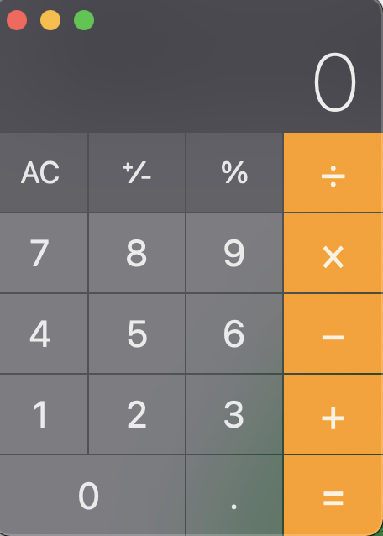
Example: Unit Test cases for Calculator app
Possible unit test cases
no UI
Test the math operations (+, -, x, /)
Test the AC function
Test the +/- function
Test the % function
UI Components
Button component should render an appropriate symbol

Slide 9
Integration Testing
E2E
Process of testing the interface between two software units or modules
Focus on determining the correctness of the interface
The purpose of the integration testing is to expose faults in the interaction between integrated units
More costly than unit testing but less expensive than E2E testing
There should be around 20% of tests added to this level
Integ
Unit

Slide 10
Example: Integ Test cases
Possible integ test cases
Clicking ‘7’, ’+’, ‘8’, ‘=‘ and verify that the display shows ‘15’
Clicking the ‘AC’ button should reset the display

Slide 11
End-to-end (e2e) Testing
E2E
Simulate a user level experience across the full stack of a software product
These tests are highly valuable to implement as they offer assurance that real users are having a smooth bug free experience, even when new commits are pushed
E2E tests can be expensive up front to capture and record the user flow sequence
Tests at this level should saved to capture design cases and requirements
They can be used to replace manual testing
Integ
Unit

Slide 12



Example: E2E Test cases
Grub
Food
Awesome Restaurant
Dishes
Dish 1
Dish 2
Dish 3
Drinks
drink 1
Drink 2
Possible E2E test cases
Select a restaurant should show up menu of the selected restaurant
Click the ‘Order NOW’ button should place an order in the cart to the server and return an appropriate response to the user
Order NOW

Slide 13
Adhere to test pyramid for quality and testability
E2E
Slow, Flaky
Integ
Unit
Fast, Easy to debug

Slide 14
There are so many JS testing Libraries. which one should I use?
Frameworks
Jest, Mocha, Protractor, Jasmine, QUnit, etc.
Browser Controller Libraries
(for E2E Testing)
Playwright, Puppeteer, FuncUnit etc.
Above are available JS testing libraries (nodejs) as of August 12th, 2021

Slide 15

Let’s apply what we learned Together!

Slide 16

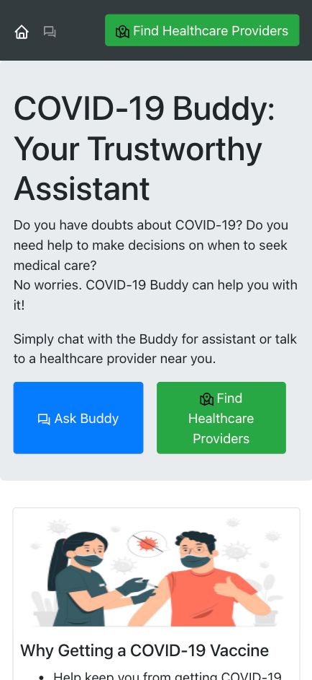



Project in devpost
Website: https://covid-buddy.herokuapp.com/
Github: https://github.com/nongnoochr/covid-buddy

Slide 17

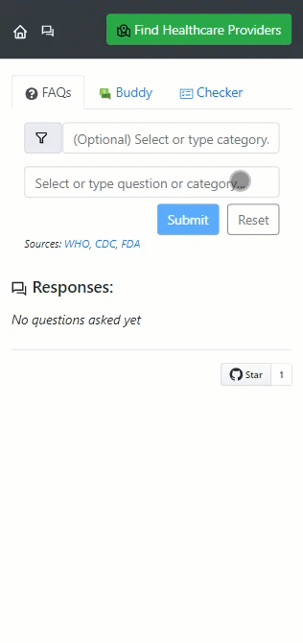
794 FAQs collected from WHO, CDC, FDA websites
AI + IQVIA HealthCare Locator SDK are integrated to suggest specialists nearby

Slide 18


Let’s add automated tests for the covid-buddy app!

Slide 19
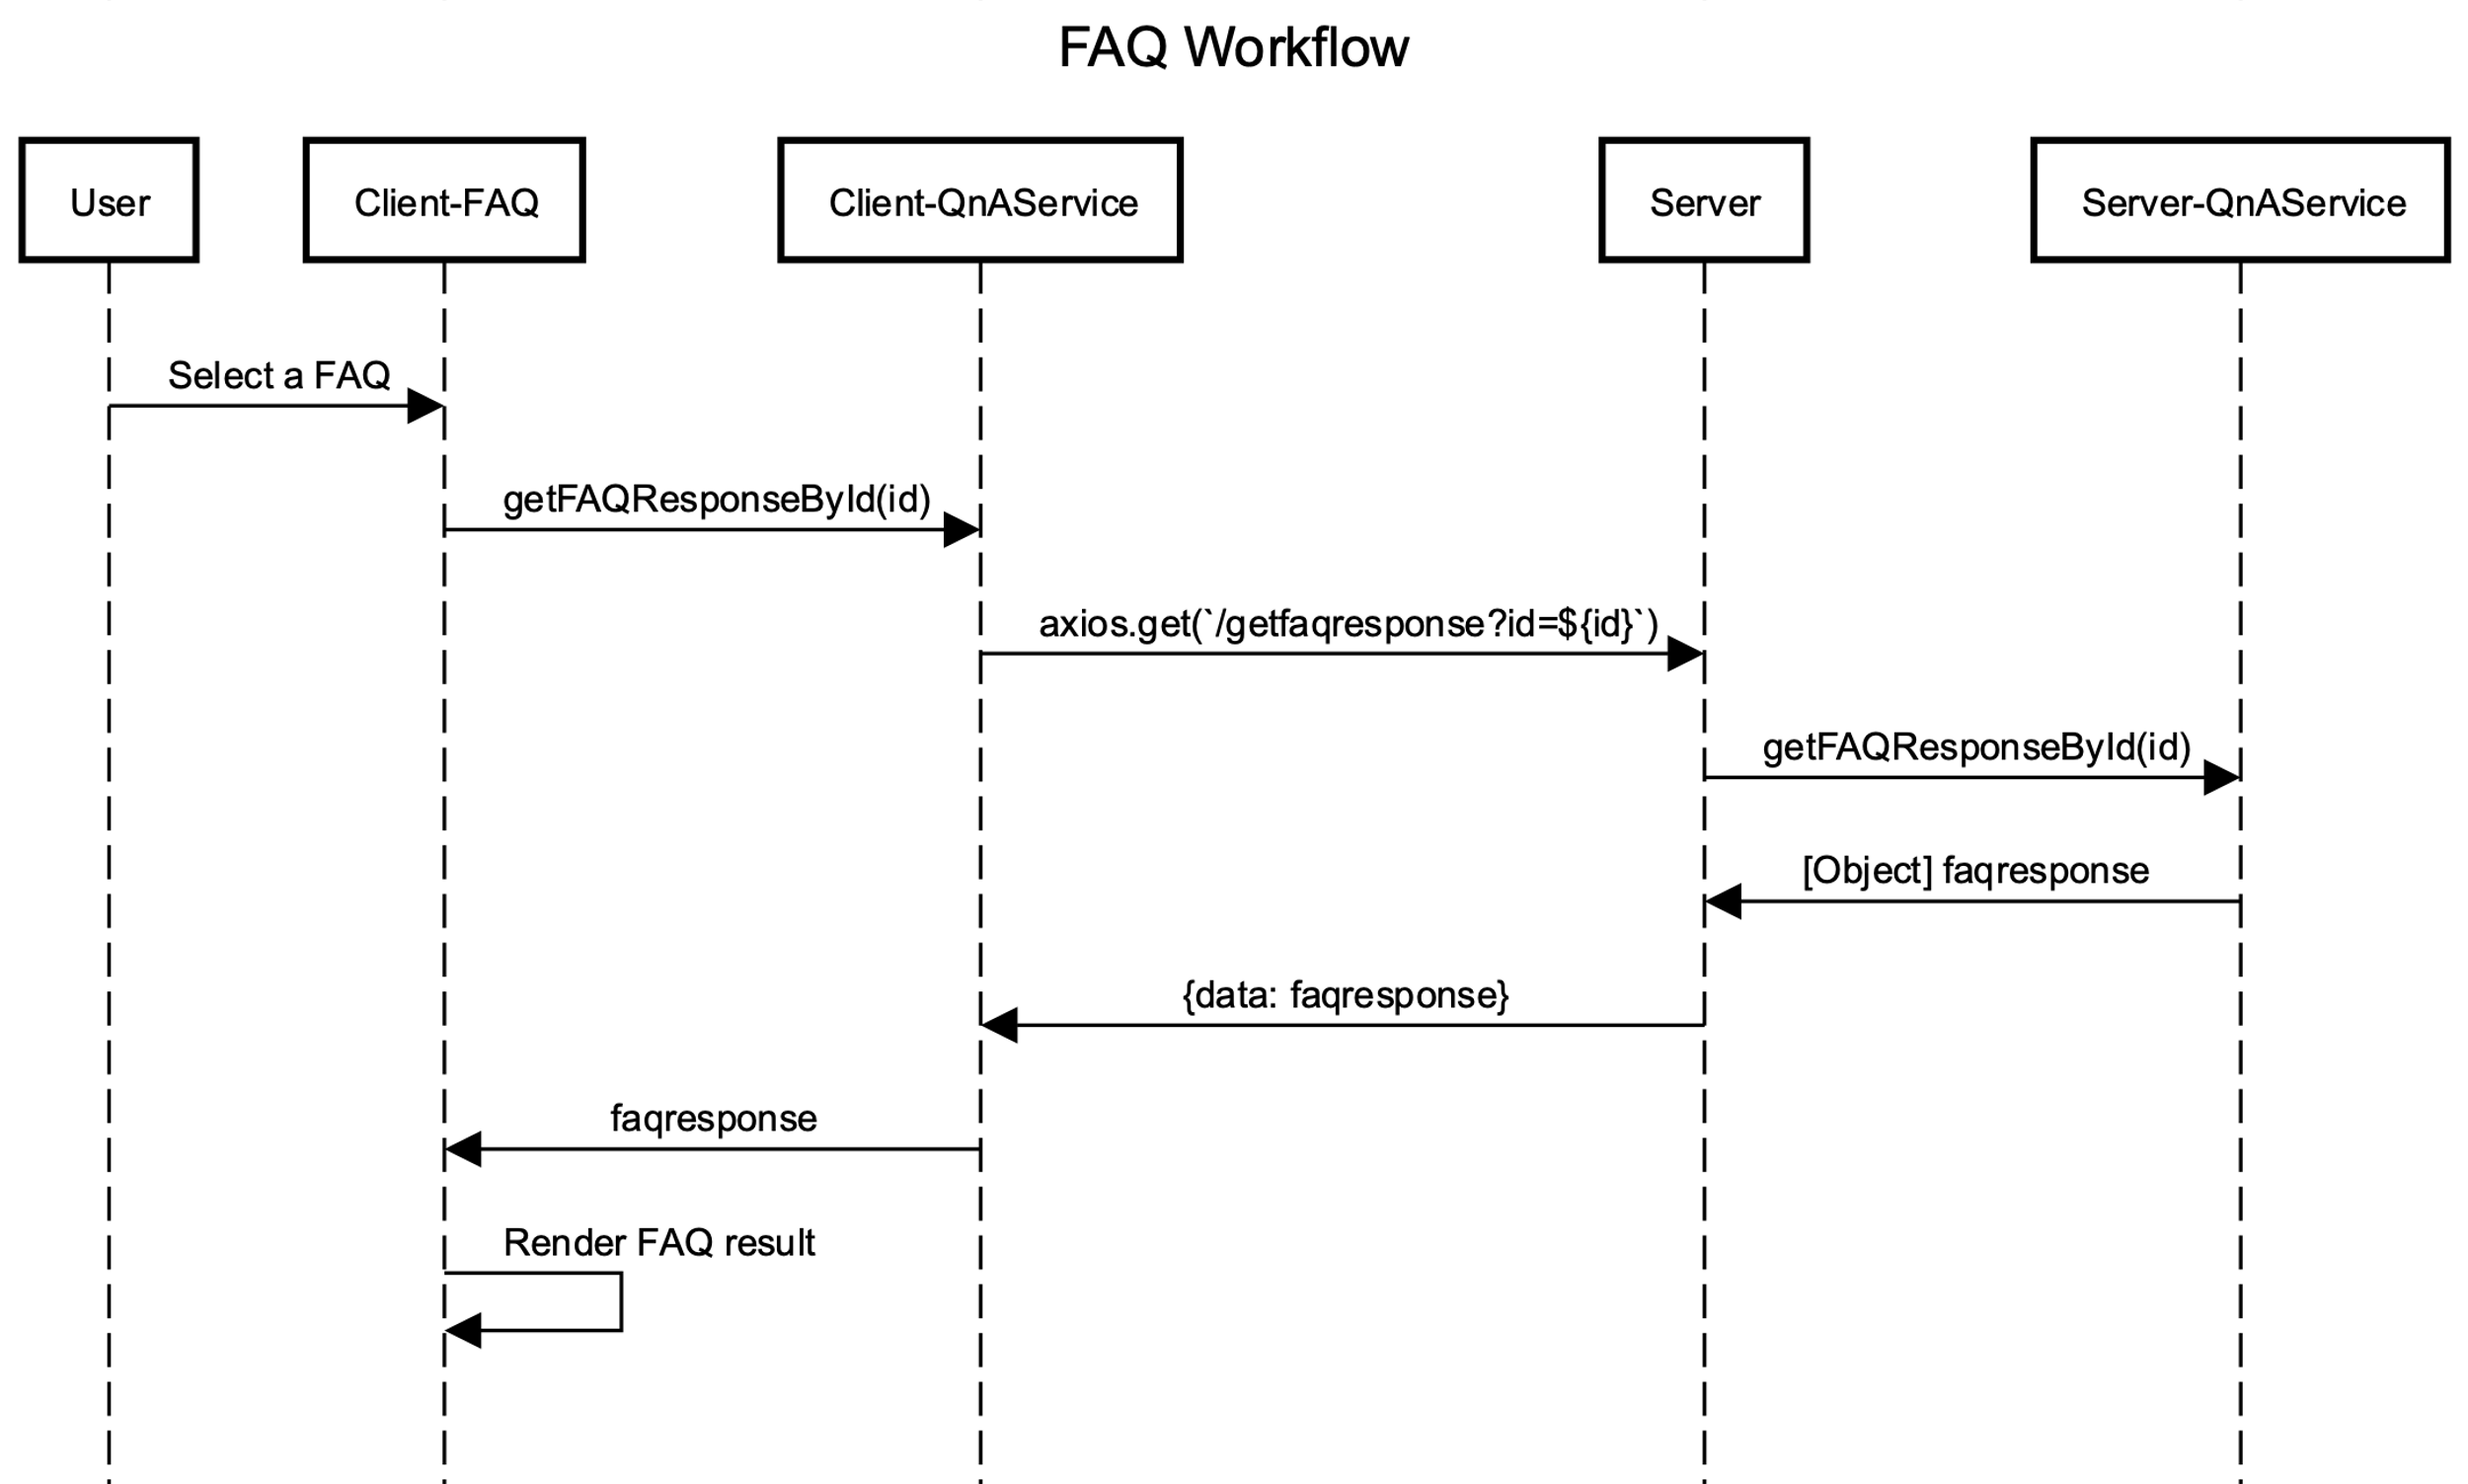
Client
Server

Slide 21
Before we start…
Get this repo if you’d like to follow along:
% git clone https://github.com/nongnoochr/covid-buddy.git
% cd covid-buddy
% yarn install (OR % npm install)
% cd client
% yarn install
% yarn build
If you’d like to run the app in dev mode
# Start server
% cd <path/to/covid-buddy>
% node index.js
# Start client app in dev mode – do this in a new tab
# Then, navigate to http://localhost:3000 in your browser
% cd client
% yarn start
* Note that the ‘Find Healthcare Provider’ feature won’t work out-of-the-box without specifying a valid apiKey for the IQVIA SDK. For more details, see instructions in README

Slide 22


What we will be using to develop Automated tests?
JS Testing Framework:
Jest
Browser Controller Library (for E2E testing):
Playwright

Slide 23
Client-side testing

Slide 24
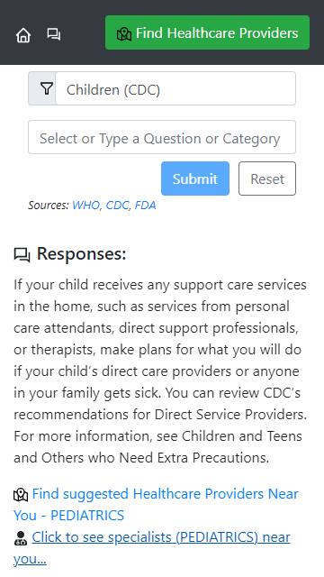
Client

Slide 25
Recap: Unit Testing
E2E
Cover individual units of code
Can be tested in isolation
Typically performed by the developer during development
Fast and easy to debug
Tests at this level should be maximized (~70%)
Integ
Unit

Slide 26
Unit test cases – No UI
Ensure that the getFAQResponseById function of the QnAService module make an appropriate request

Slide 27
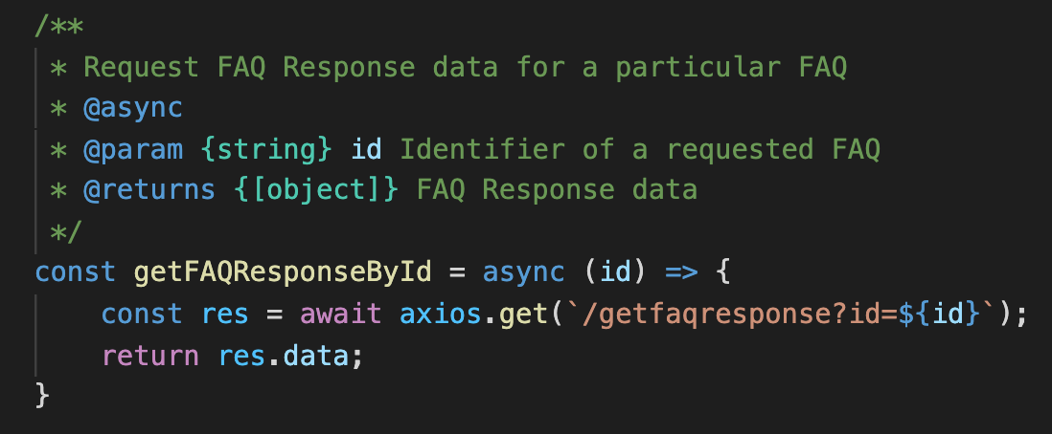
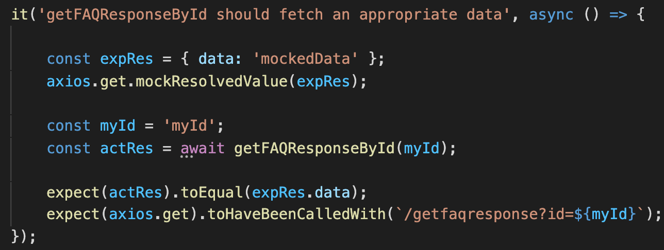
To run test
% cd client
% yarn test
Source: services/QnAService.js
Test: __tests__/services/QnAService.test.js

Slide 28
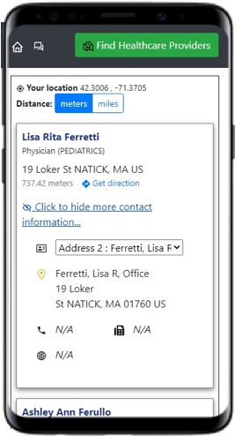
Unit test cases –UI component
Ensure that the HCPInfo component renders appropriate information based on the input data

Slide 29
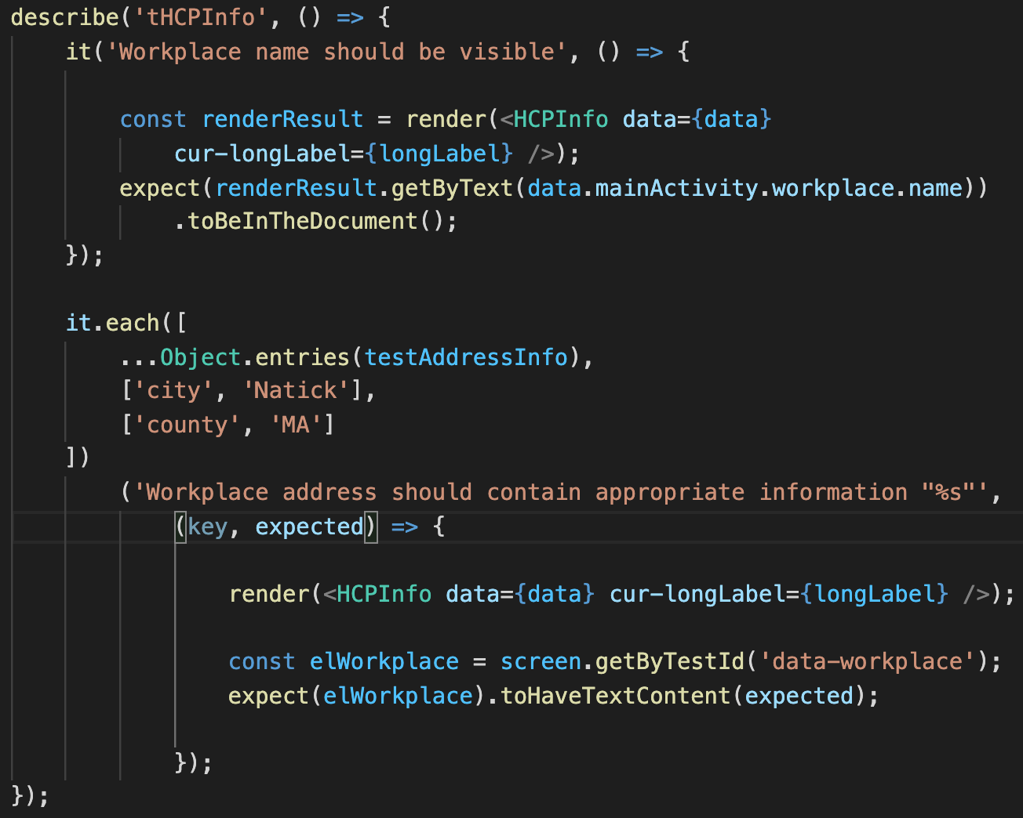
Source: components/QnA/HCPInfo.js
Test: __tests__/components/HCPInfo.test.js

Slide 30
Recap-Integration Testing
E2E
Process of testing the interface between two software units or modules
Focus on determining the correctness of the interface
The purpose of the integration testing is to expose faults in the interaction between integrated units
More costly than unit testing but less expensive than E2E testing
There should be around 20% of tests added to this level
Integ
Unit

Slide 31
Integ test cases
Ensure that after clicking the ‘Ask Buddy’ icon in the Navigation bar,
The pathname is updated to ‘/askbuddy’
The app is re-rendered to show the Buddy page

Slide 32
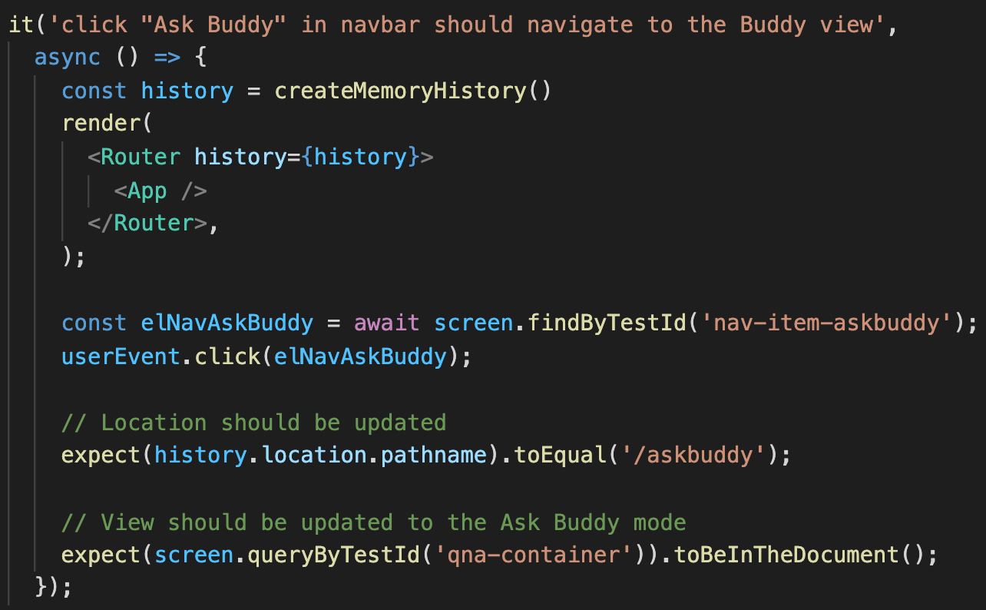
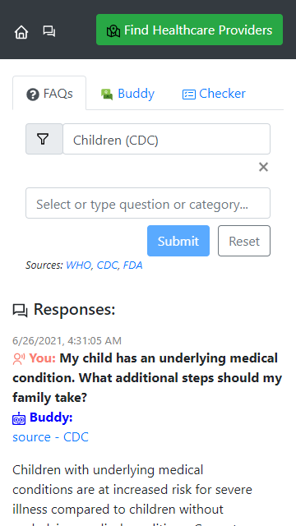
Source: App.js
Test: __tests__/App.test.js

Slide 33
How did we do so far? Code coverage collection
To collect code coverage in jest, using the command below*
% yarn test --coverage --watchAll
*Note: the ‘—watchAll’ option is required to temporary workaround an open issue as describe below (as of August 13th, 2021)
https://stackoverflow.com/questions/57451028/jest-finds-tests-but-doesnt-collect-coverage

Slide 34
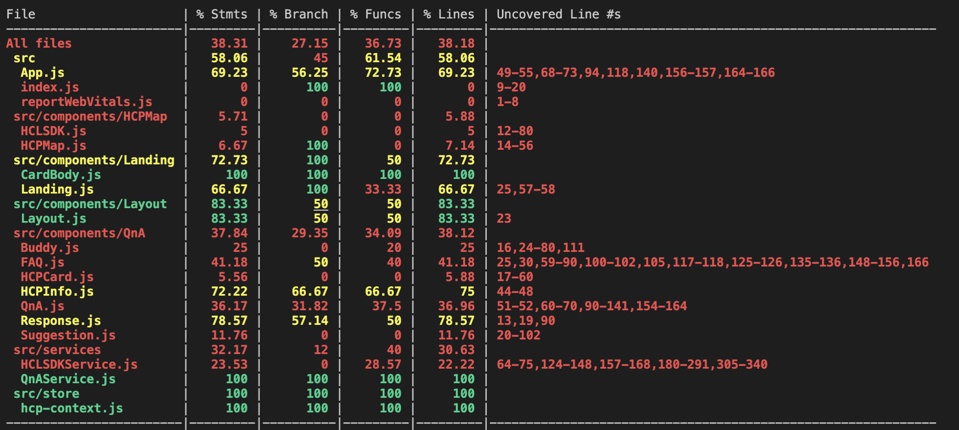
Code coverage results (CLI)

Slide 35
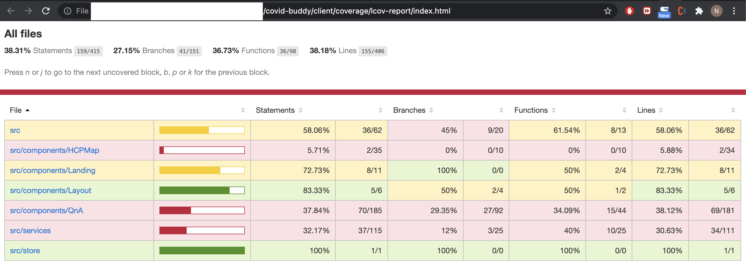
Code coverage results (Report)

Slide 36
Server-side testing

Slide 37
Server

Slide 38
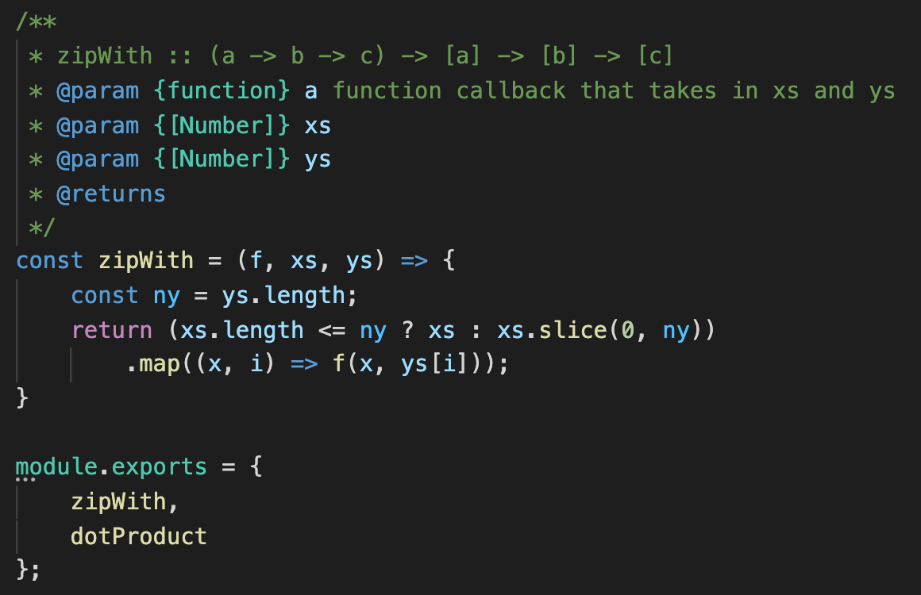
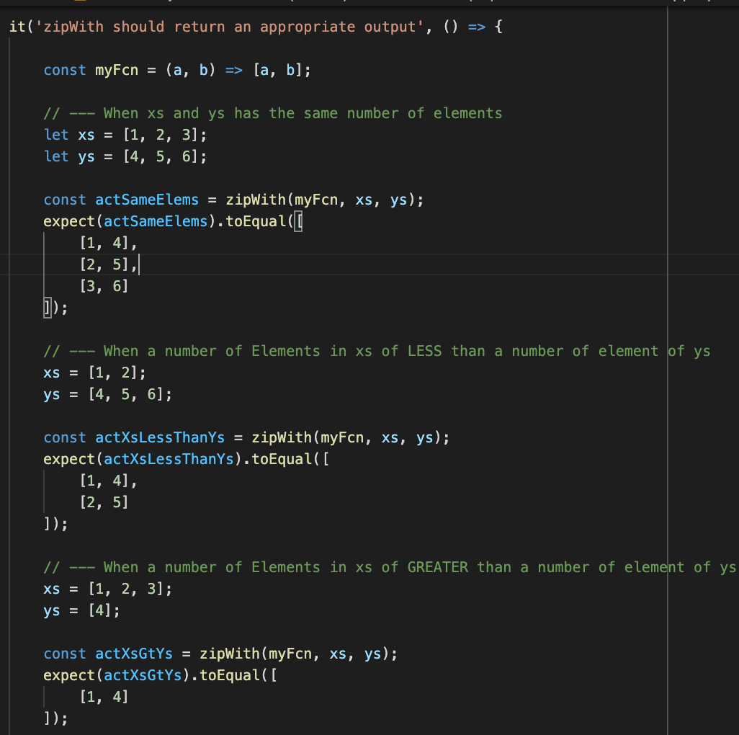
Source: server/Utils.js
Test: __tests__/server/Utils.test.js
To run test
% cd <prj_root>
% npm run test-server

Slide 39
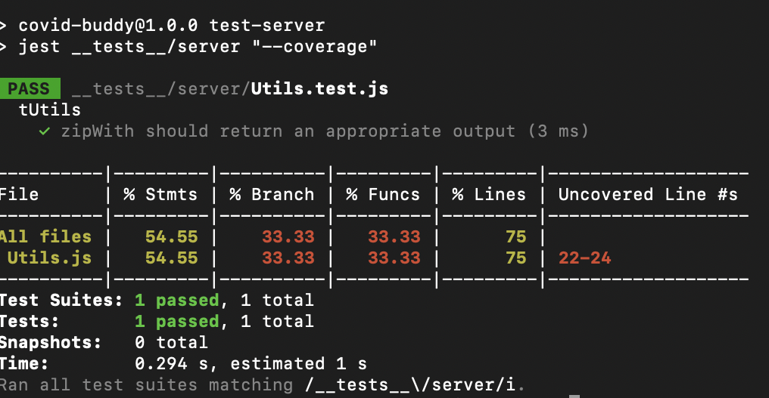
What is our code coverage (server)?
% npm run test-server -- --coverage

Slide 40
End-to-End Testing

Slide 41
Recap: End-to-end (e2e) Testing
E2E
Simulate a user level experience across the full stack of a software product
These tests are highly valuable to implement as they offer assurance that real users are having a smooth bug free experience, even when new commits are pushed
E2E tests can be expensive up front to capture and record the user flow sequence
Tests at this level should saved to capture design cases and requirements
They can be used to replace manual testing
Integ
Unit

Slide 42
E2E test cases
Open a production app, then
Select a FAQ
click Submit
Verify that an appropriate response retrieved from the server is rendered properly
Ensure that this design case work properly across browsers (chromium, webkit, firefox) and devices (desktop, mobile devices)
To run E2E tests, use the command below
% npm run test-e2e

Slide 43
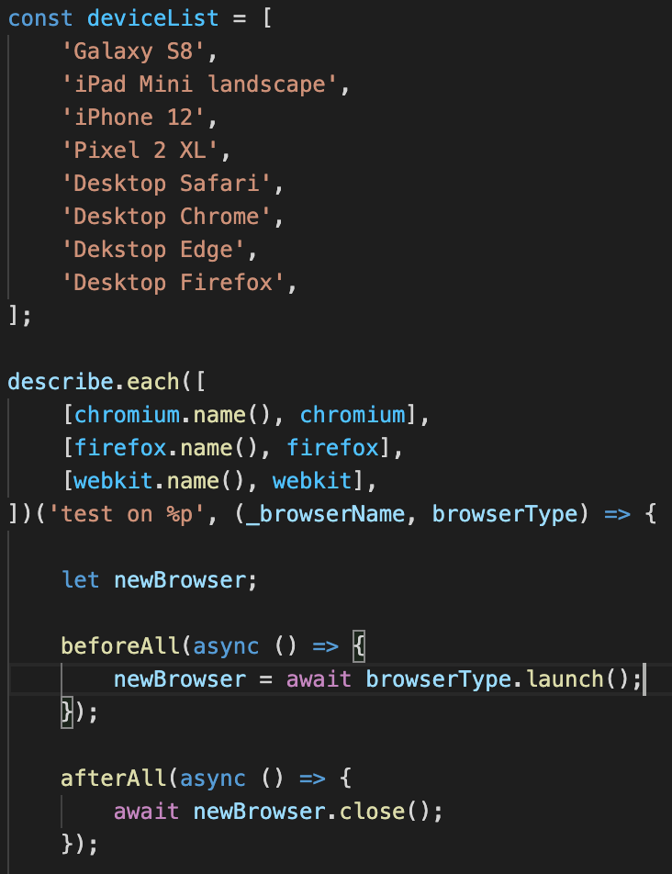
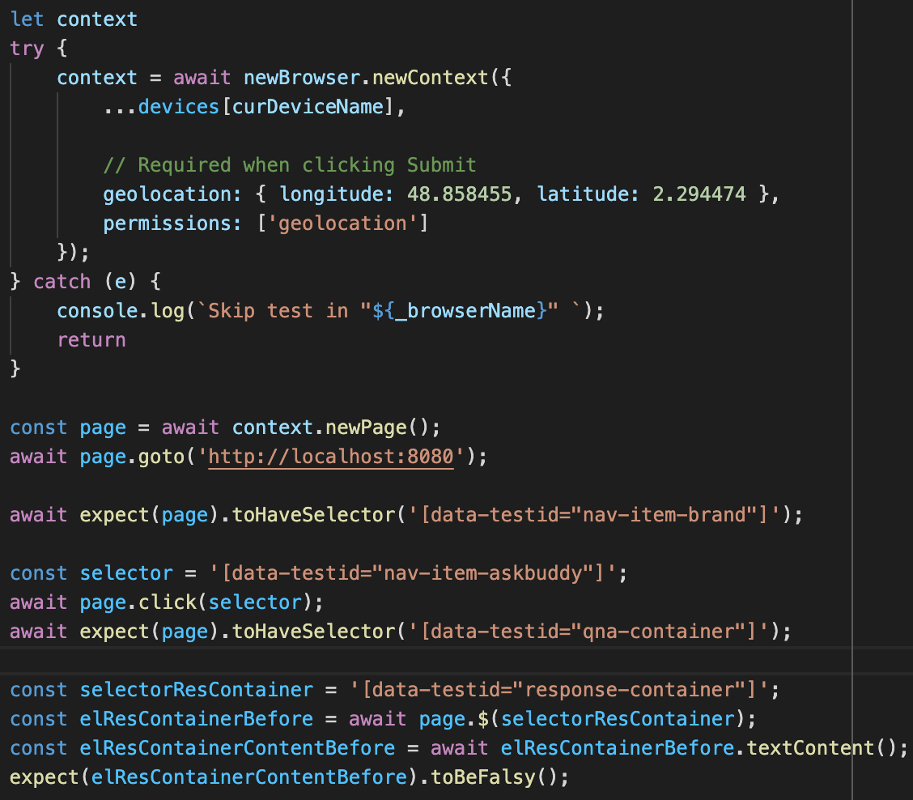
Test: __tests__/e2e/prodApp.test.js

Slide 44
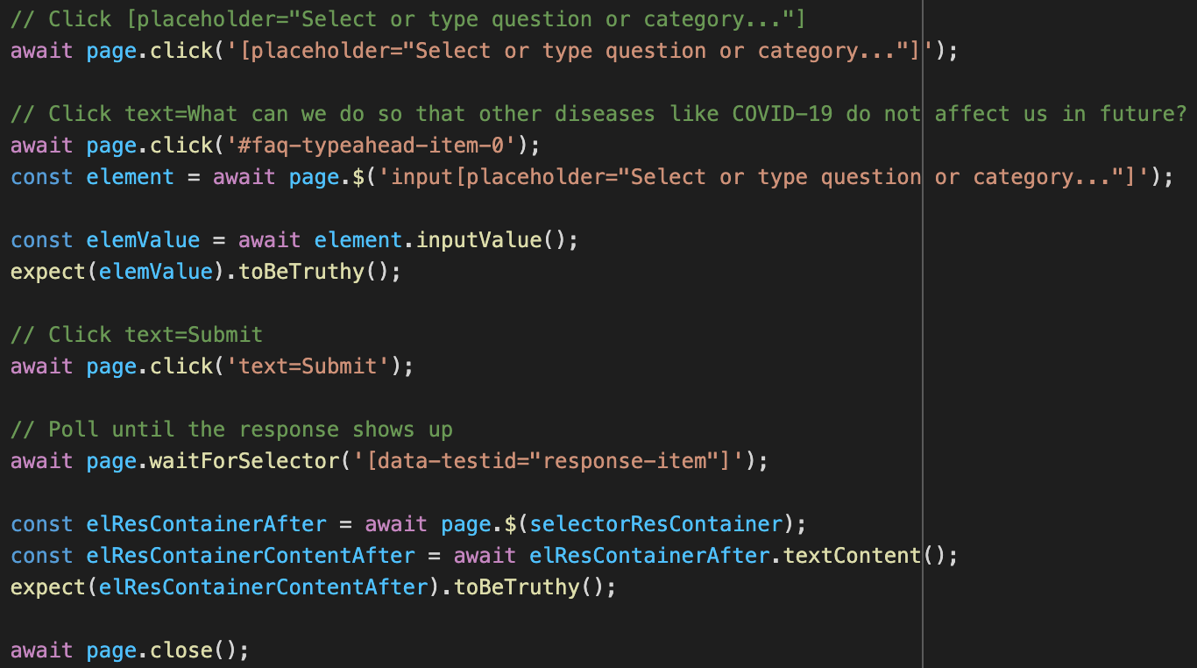
These commands to interact with a browser can be automatically generated through the ‘recording’ feature that is available after invoking
‘await page.pause()’ ☺

Slide 45
Takeaways
Use TESTABILTIY as a lens of your design
Adhere to Test Pyramid when developing automated tests for your project

Slide 46

That’s it! Have fun testing in your next project ☺

Slide 47
Resources
GitHub Project: https://github.com/nongnoochr/covid-buddy
This presentation is available in artifacts/intro_automatedtesting.pptx
https://jestjs.io/
https://playwright.dev/

Slide 48

Questions?

